Slide 1
Fairhaven
High School
Cross Country
After 2 years of being self-supporting to exist, Lyle Drew organized a road race that increased funding by almost 3xs the amount:
Bussing/meet & invitational costs
$500 scholarships were established for senior runners
Sweatsuits were purchased
Other equipment (including TENT) was purchased

Slide 2
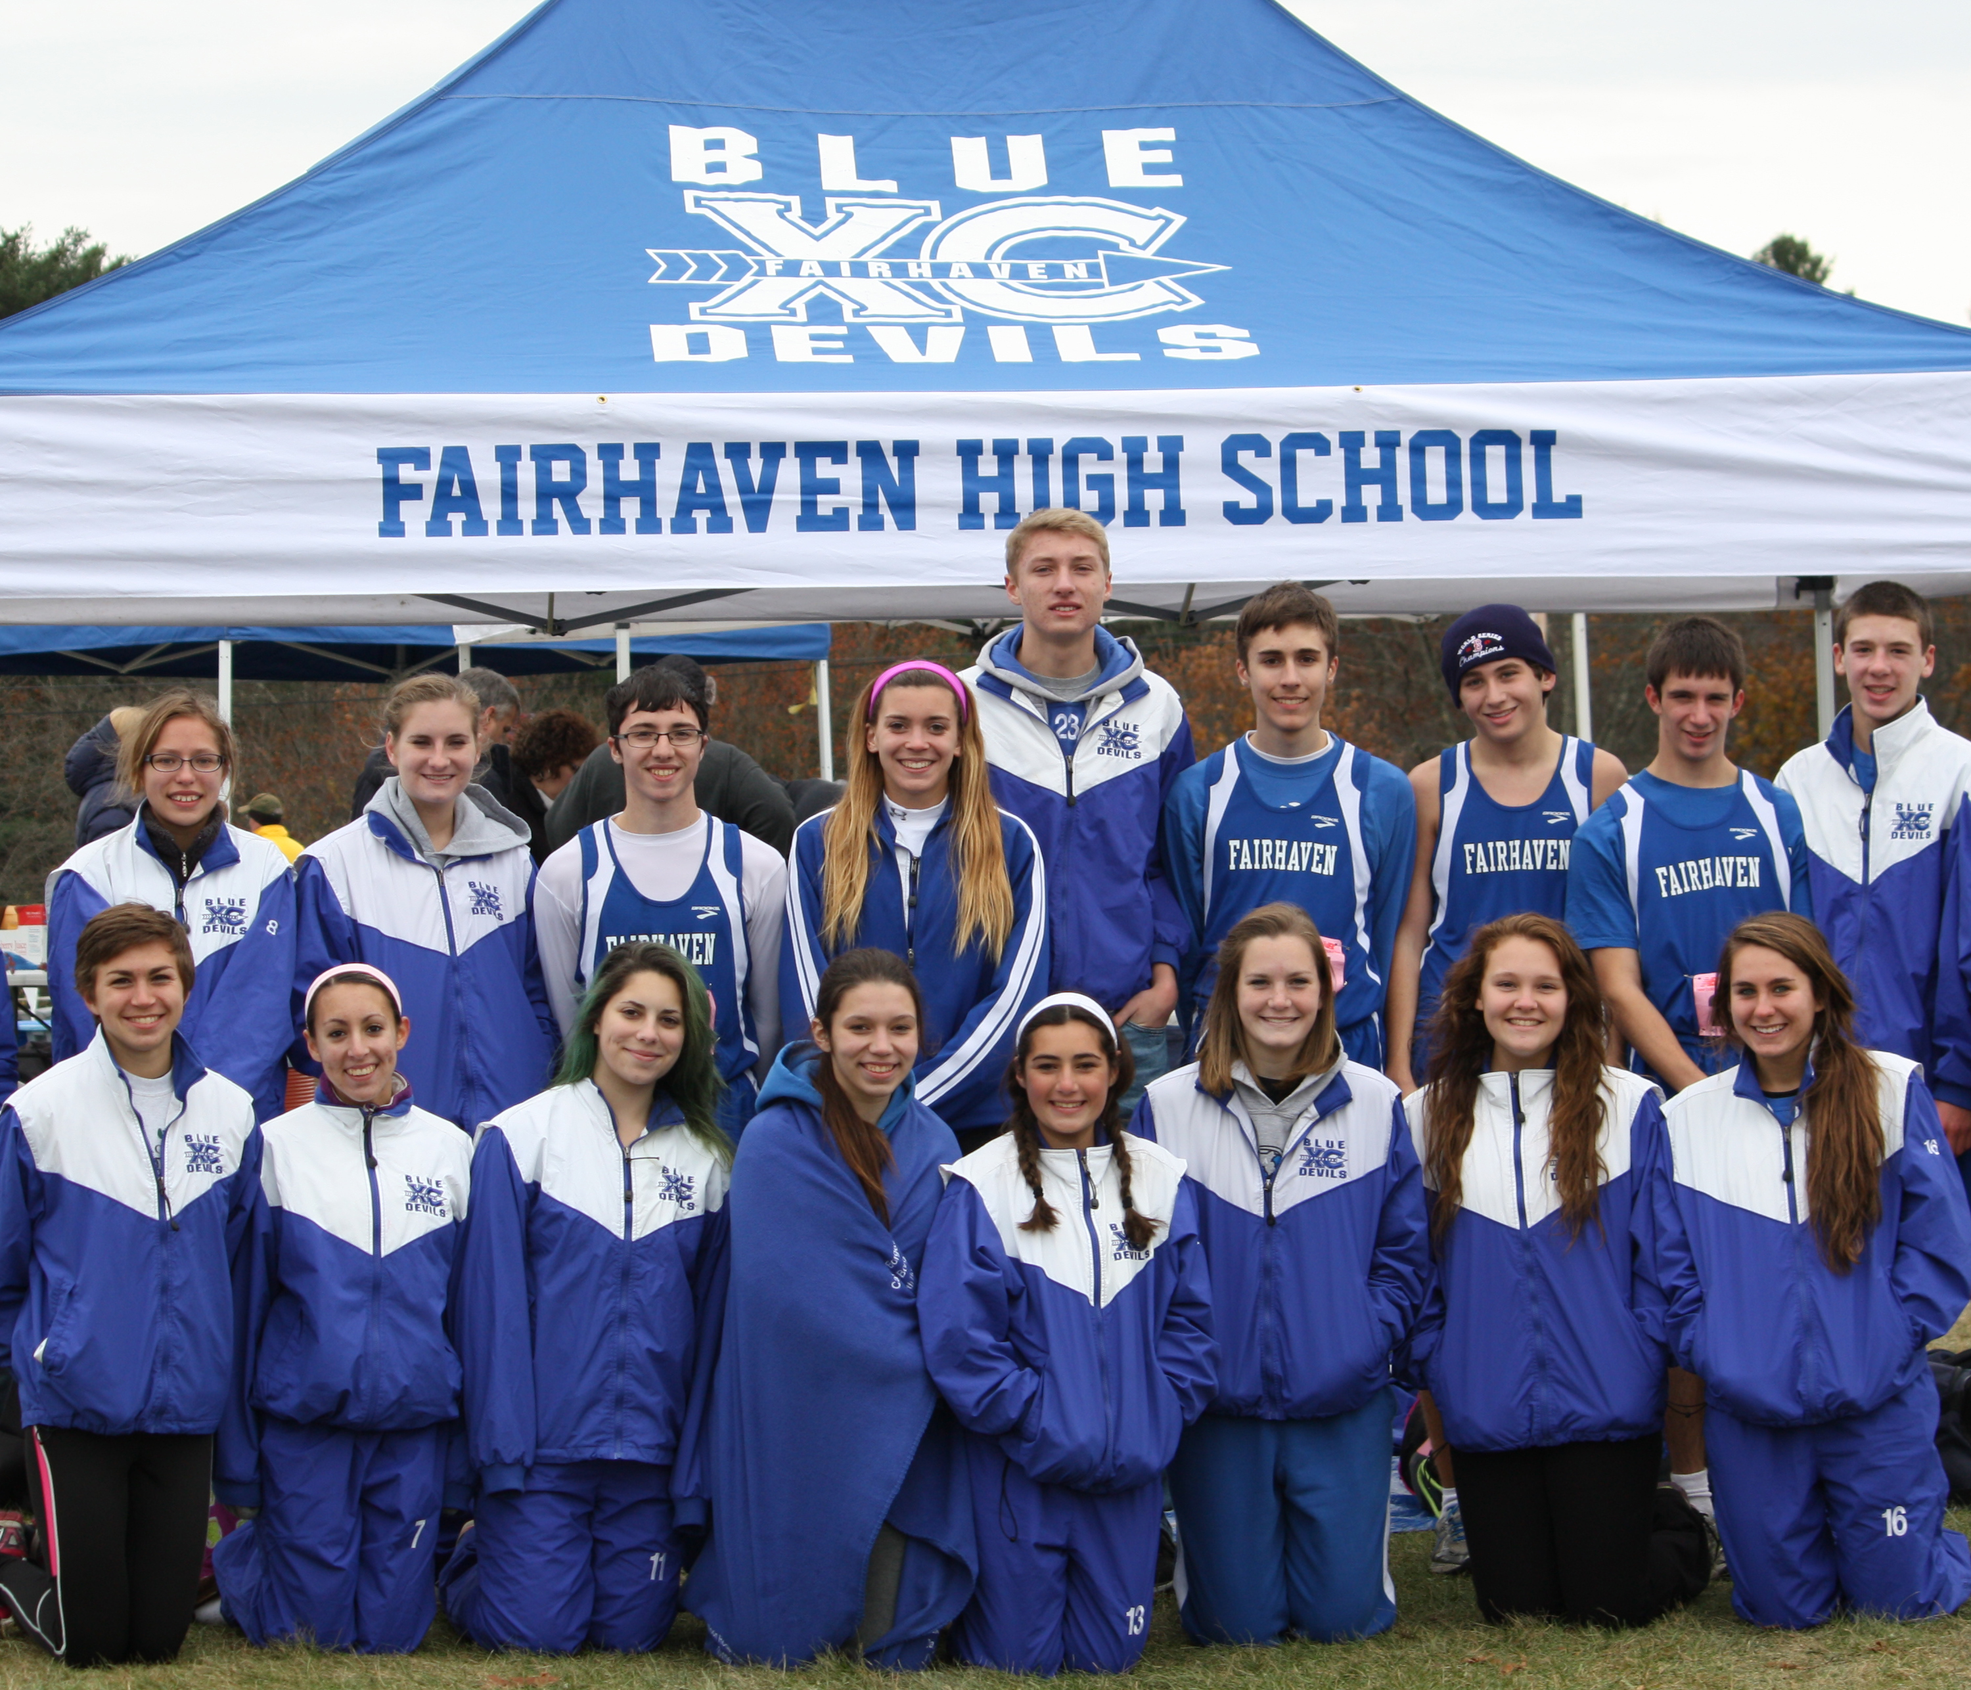
In fact, at the MSTCA meet on Nov. 2, parents came over to ask about our tent because they wanted to buy one for their team, and it was “by far, the best looking one” out there that day. At least 50 tents were there too!

Slide 3
Fairhaven
High School
Cross Country
2013
School sponsored cross country:
Only some invitational costs ($800) were not covered
West Island 5K paid for:
$800 invitational
All Martha’s Vineyard Costs ~ $500
Yoga Class $200
5 Scholarships
Weights/plyometric balls ~ $400
Extra water/course markings/etc for home meets ~ $200

Slide 4
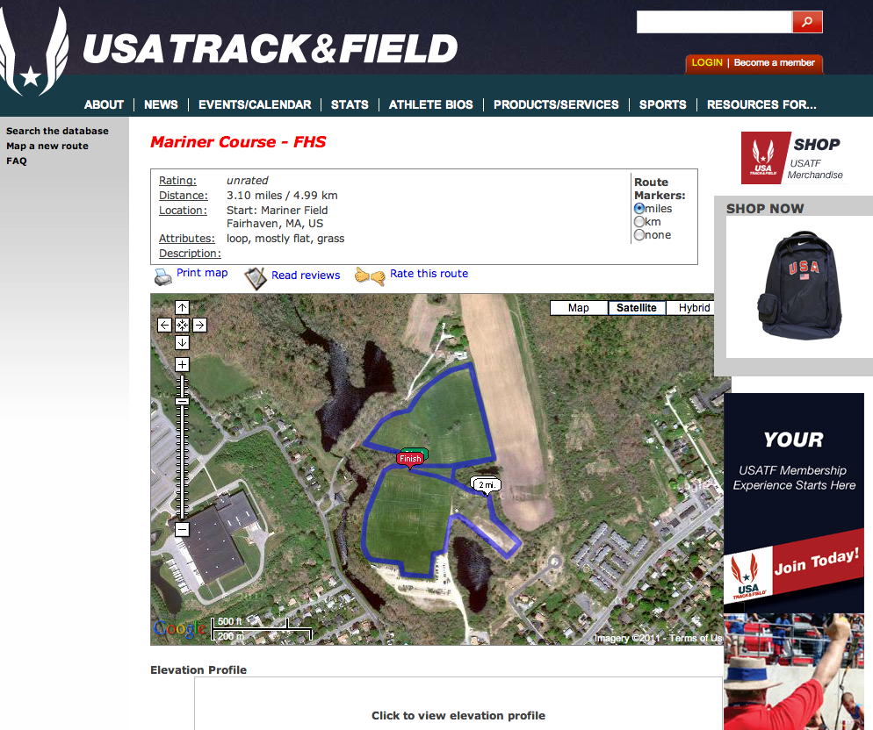

Slide 5
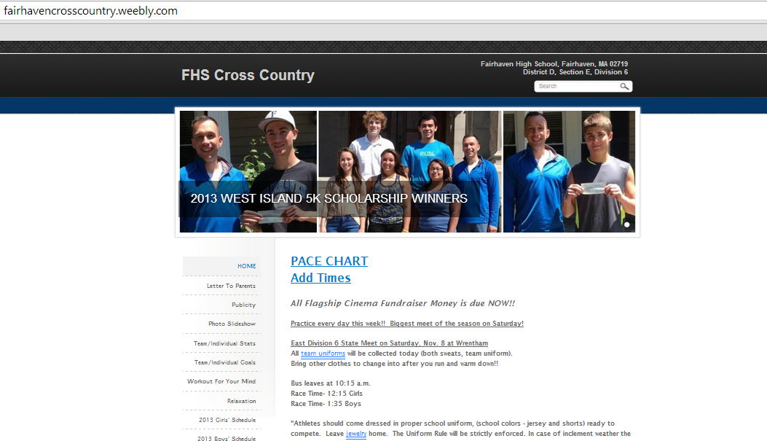

Slide 7
FINAL
SCC
STANDINGS
MEN’S STANDINGS
Seekonk 6-0
DR 5-1
OR 4-2
VT 3-3
Bourne 2-4
Apponequet 1-5
Fairhaven 0-6
WOMEN’S STANDINGS
OR 6-0
Fairhaven 5-1
DR 4-2
Bourne 3-3
Seekonk 2-4
Apponequet 1-5
VT 0-6

Slide 9
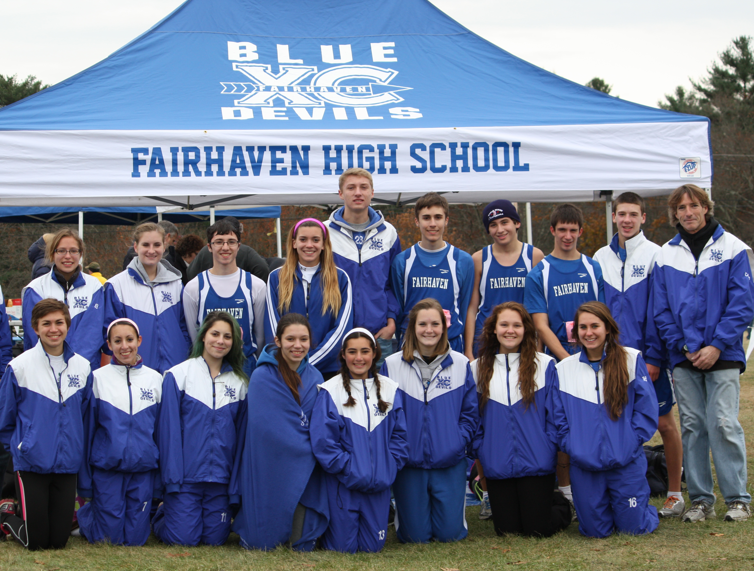

Slide 12
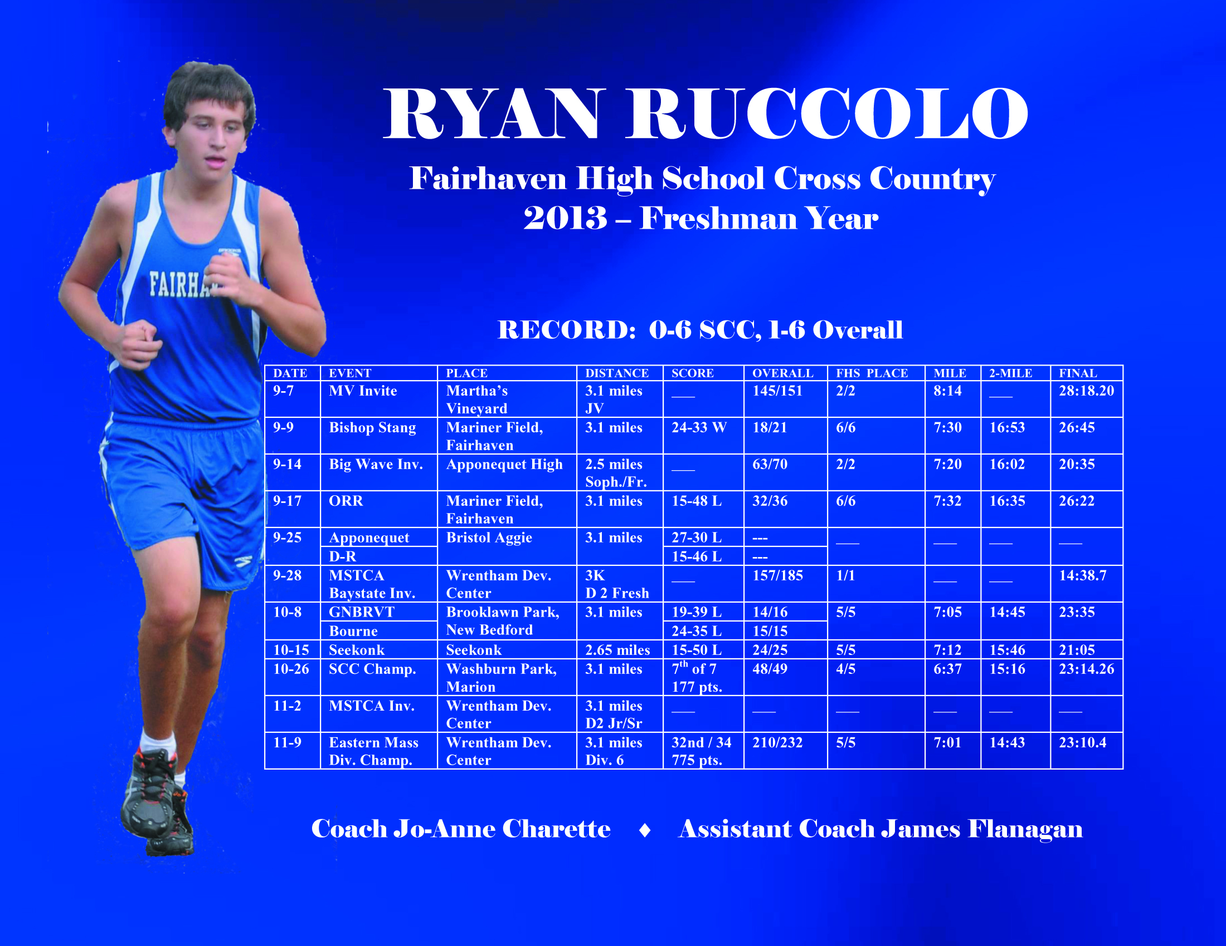

Slide 14
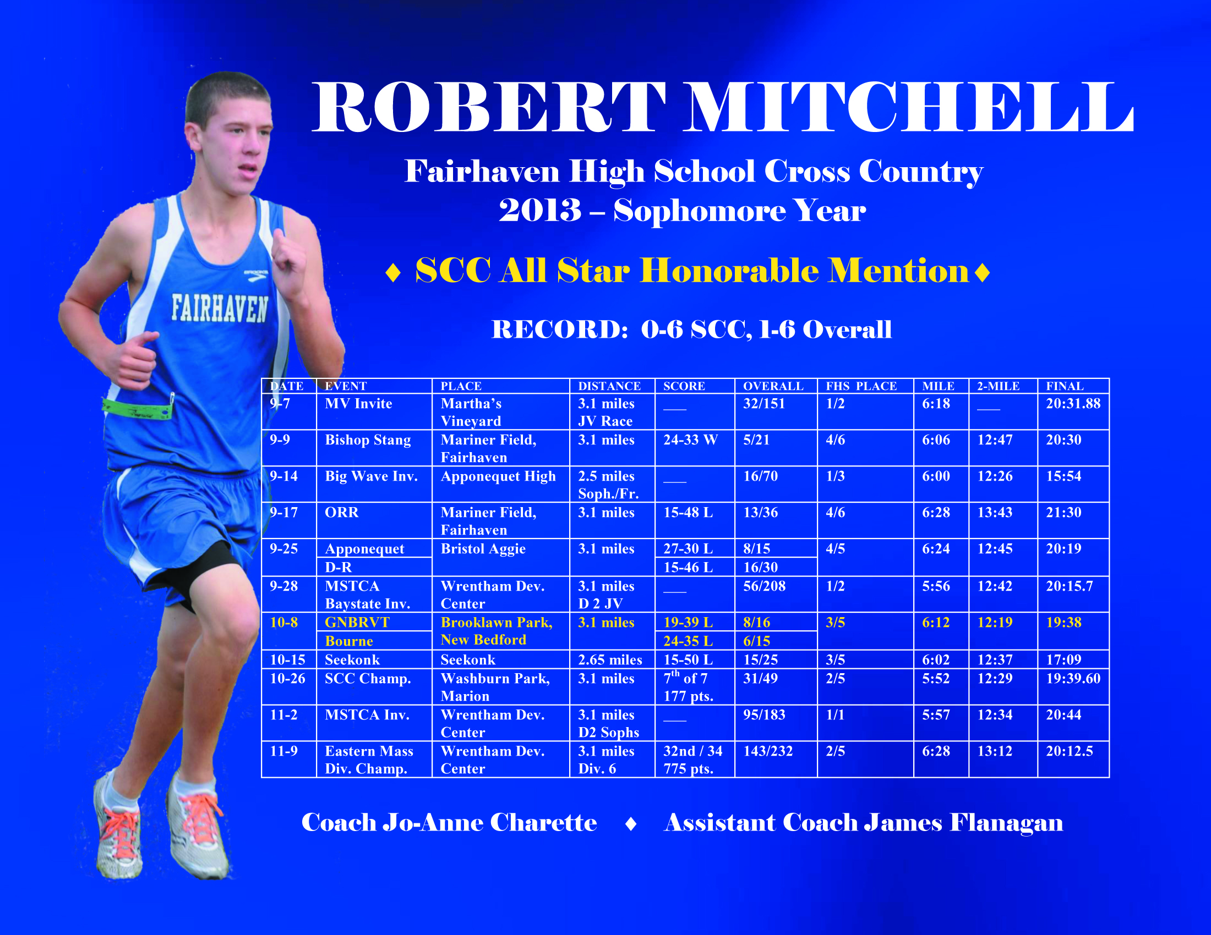

Slide 24
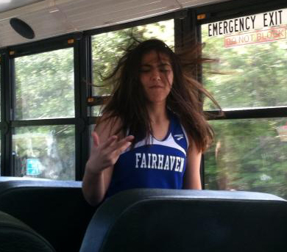

Slide 31
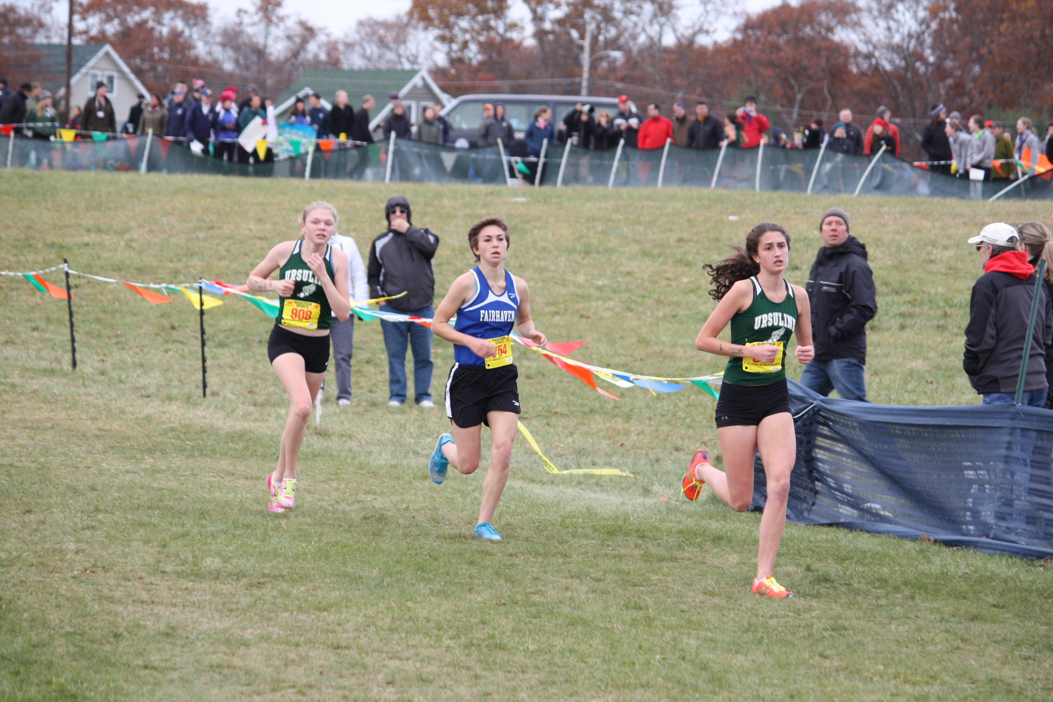

Slide 32
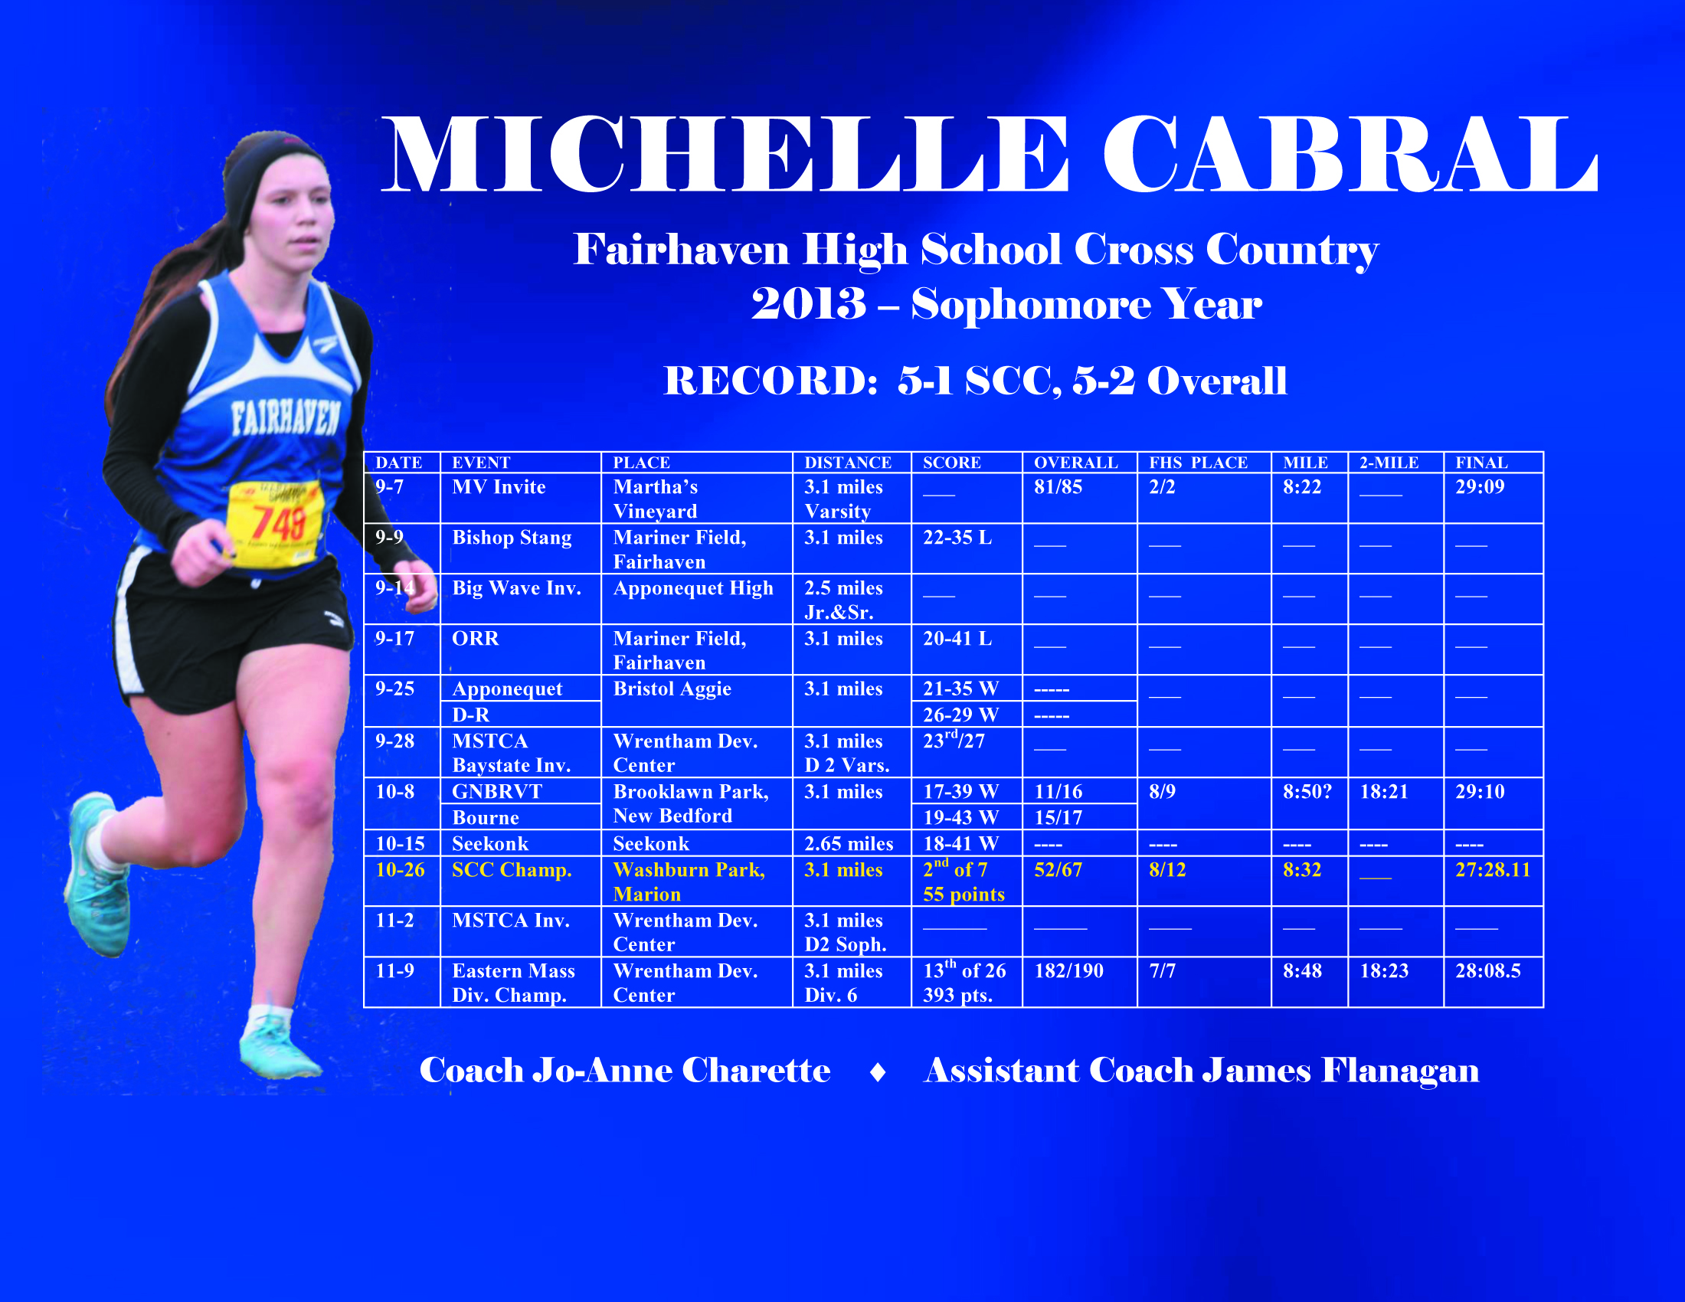

Slide 49
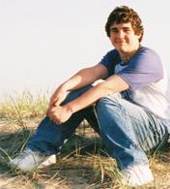
Matty Oliveira Award
For the male or female runner who most demonstrates his or her love for life and the people in it, along with his or her willingness to challenge him/herself to go beyond his/her capabilities in both athletics and academics. The award-winning athlete will receive a plaque with his or her name and the name of the award engraved.
“Matty” Oliveira, a Fairhaven resident, died four days after falling off a go-cart and sustaining a severe head injury. His fight for life during those four days truly demonstrated the heart and determination of this 13 year-old boy. He was a happy-go-lucky child from the day he was born. Matty had a very unique personality. He inspired people to strive for more and challenge themselves. Matthew was kind and loyal and when you met him, you became a friend for life. With his contagious spirit, he managed to touch thousands of hearts in his short stay here on earth. Matty enjoyed all sports, football being his favorite. His strong physique and desire to compete allowed him many accomplishments. School was very important to Matty. His photographic memory and high intellect was challenged only by his sense of humor. Matty’s true gift was his ability to find the special qualities in others. He was non-judgmental and unprejudiced.
And the winner is….

Slide 51
Fairhaven Road Race Award
For the male and/or female runner who has contributed the most to the team's record and league standings. The award-winning athlete's name will be engraved on a plaque that will stay in the athletic foyer with winners each year. The runner will receive a plaque with his or her name and the name of the award engraved. This award truly embraces the caliber of the athlete needed to make F.H.S. Cross Country more competitive.
And the winners are….

Slide 55
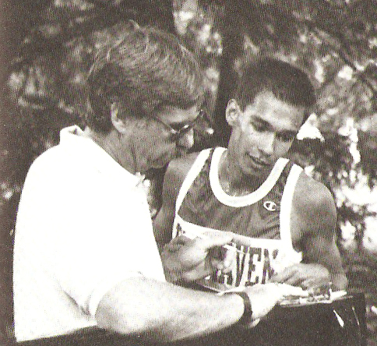
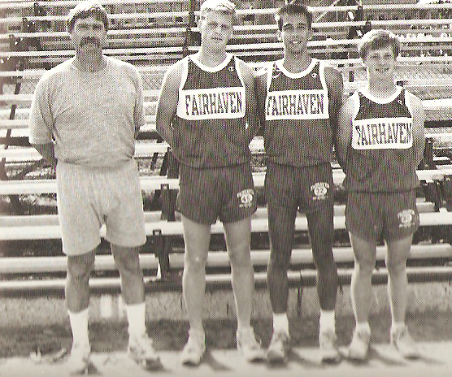
Lyle Drew Award
For the male or female runner with the highest regard for the importance of teamwork, leadership, and a strong work ethic. The award-winning athlete's name will be engraved on a plaque that will stay in the athletic foyer with winners each year. The runner will receive a plaque with his or her name and the name of the award engraved. This award truly embraces the passion Lyle Drew (Class of 1990) had during his four years of participating on the F.H.S. Cross Country team and still has to this day.
And the winner is….

Slide 61
THANK YOU PARENTS
For your support with bringing baked goods to our home meets.
For coming and helping at the home meets.
For helping to get your child to meets on time!
For being supportive of the program!
Be a part of the West Island 5K Organizing Team. Give Lyle Drew your email address and he’ll add you to his list. Any help, big or small, is welcome!

Slide 62
QUOTE TO REMEMBER
In running, it doesn’t matter whether you come in first, in the middle of the pack, or last. You can say ‘I have finished.’ There is a lot of satisfaction in that. Author Unknown

Slide 63
Dear 2013 FHS Cross Country Runner:
Thank you for your commitment to the your coaches, the team, your parents, and yourself this past season. Dedication/commitment and a positive attitude are the most important qualities you can give to any team. The better times and performances will all come when you display these qualities.
It’s always sad to come to the end of your season, but hopefully, we helped to give you great memories and inspiration for being a better overall person by digging deep to find the strength within yourself to accomplish what you set out to do. Cross country is a grueling sport , and making the commitment to be a part of that shows that you have what it takes to be successful at whatever you pursue in life.
Long distance running has been a part of my lifestyle since I entered high school way back when, and my hope is that it will do something like that for you too. Let’s continue to keep the cross country program alive and strong at Fairhaven High. Spread the word to all other potential athletes for next season, as it all starts with you! Have a great rest of the year and do your summer training for 2014!
Your Coach,
Jo-Anne Charette

